Slide 1



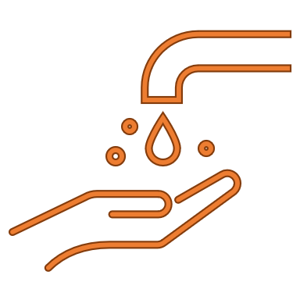










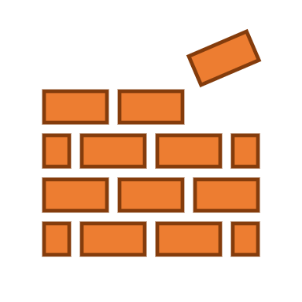
Wastewater Treatment Facilities: 3
Communities Served: 62
Total Service Area:
363.626 square miles
Watershed Communities: 5
(Rocky River, Cuyahoga River North, Cuyahoga River South, Chagrin River and Lake Erie Tributaries)
Pump Stations: 15
Subwatersheds: 139
Closed Conduit Miles (including CSI): 127.81
Number of Streams: 3,356
Closed Conduit Miles (excluding CSI): 94.76
Miles of Streams: 943
Number of Culverted Streams: 260
Percent Impervious: 34%
Total Impervious Area: 129.9 square miles
SMP Parcels: 431,613

Slide 2
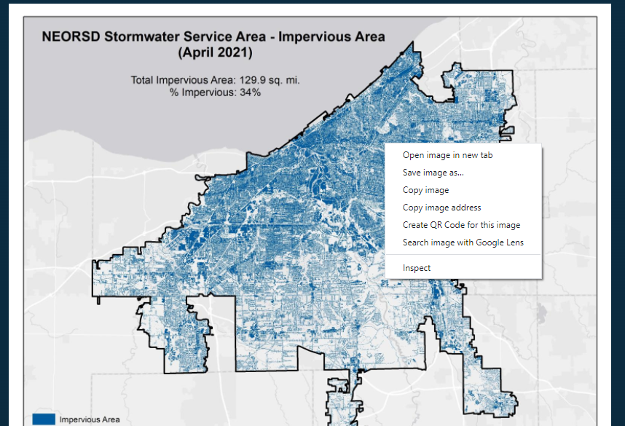

Slide 3

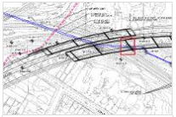
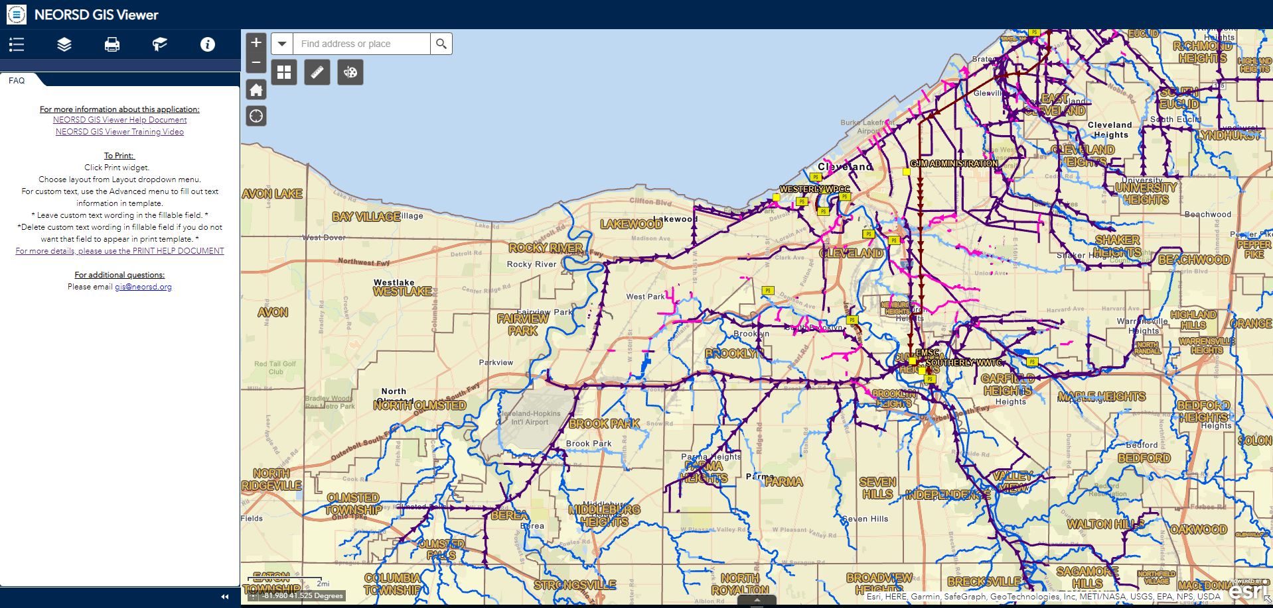
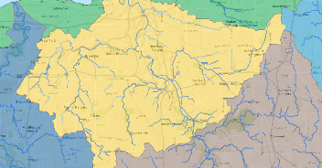
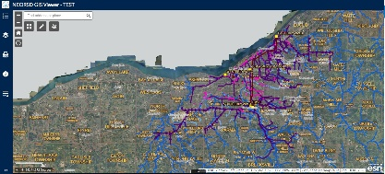
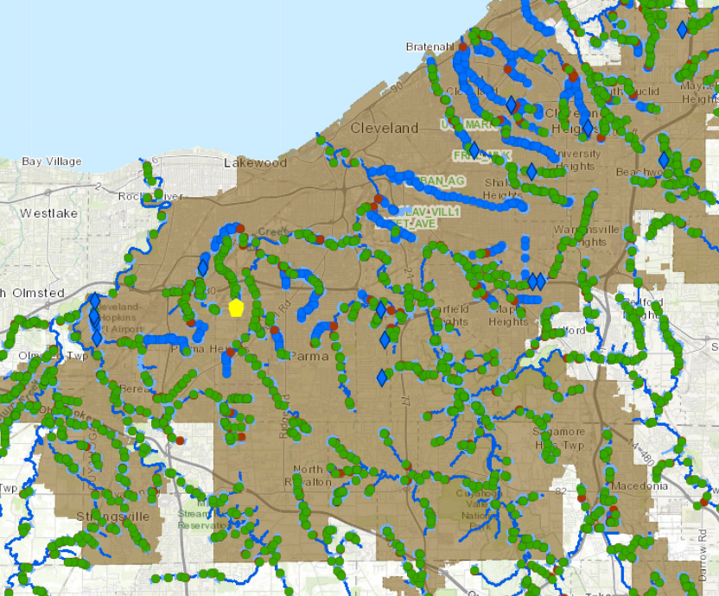
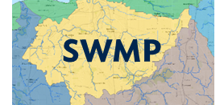

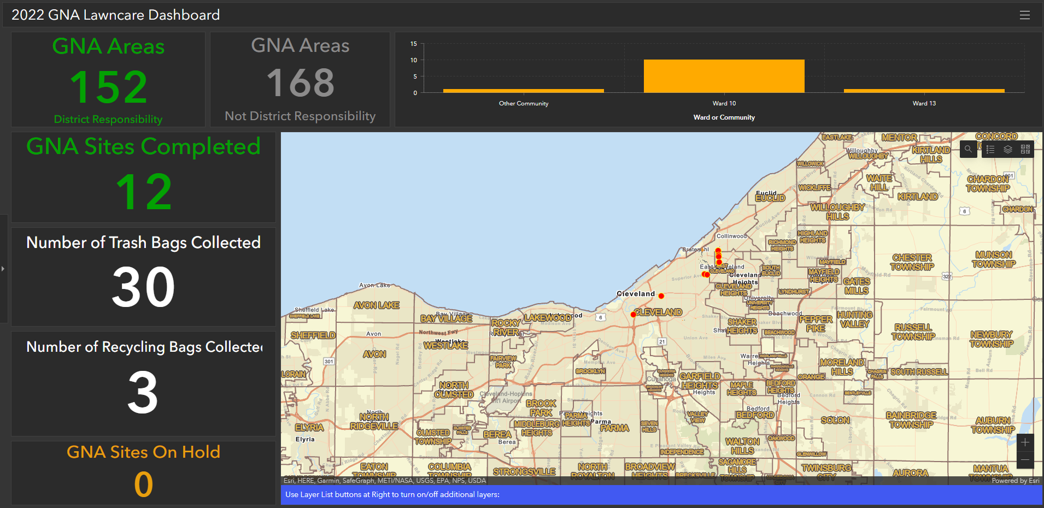
GIS Service Request
Requires
ArcGIS Online
Log In
SWMP
NEORSD
GIS VIEWER
Requires
ArcGIS Online
Log In
Report A
Flood Tool
(RAFT)
Requires
ArcGIS Online
Log In

